Slide 1
{ AOP For You And Me }
{ Matthew D. Groves }

Slide 2

http://pixabay.com/en/spaghetti-spaghetti-carbonara-7115/
Notes:
Reduce spaghetti code – cross cutting concerns code that gets tangled up with other code

Slide 3

http://www.flickr.com/photos/syntopia/6005866895/
Notes:
Reduce repetition and boilerplate – less is more, let’s avoid writing the same thing over and over if we can

Slide 4
{ A little about me }
I’ve been writing code since I was 8
I mainly work with .NET, but I also work with PHP and other OSS
BS, MBA, Microsoft MVP, PostSharp MVP
“I am not an expert, but I am an enthusiast!” – Alan Stevens
Notes:
Please ask tough questions and challenge me, give me feedback and help me improve

Slide 5
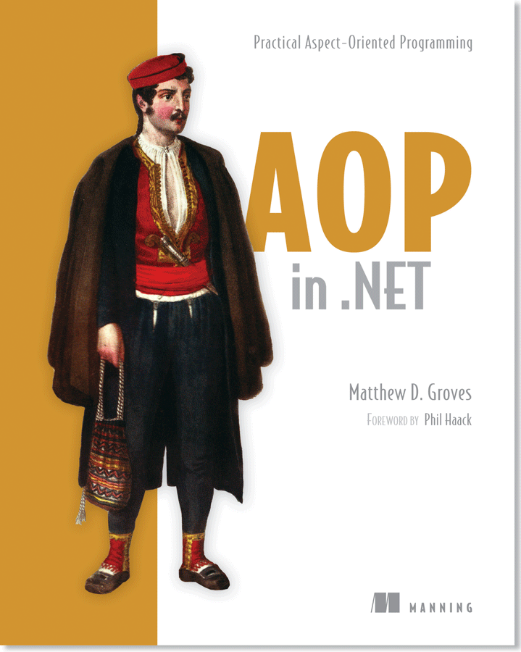
http://crosscuttingconcerns.com http://manning.com/groves

Slide 6

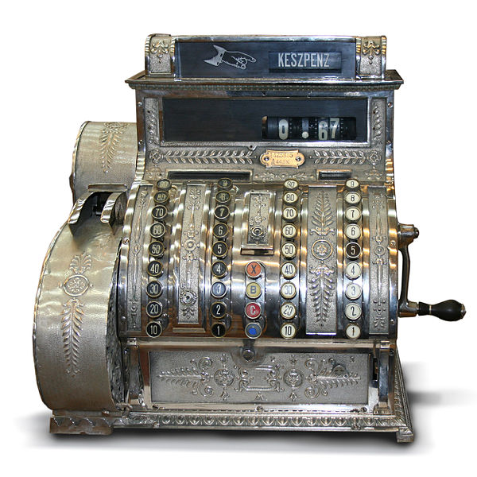
{ Cross-cutting concerns }
validation
INotifyPropertyChanged
Logging
Transactions
authorization
Caching
Defensive
Programming
exception handling
http://commons.wikimedia.org/wiki/File:Hungarian_Antique_three-column_full-keyboard_cash_register_1902.jpg
http://commons.wikimedia.org/wiki/File:Logging_operations_at_Millmoor_Rig_-_geograph.org.uk_-_530424.jpg

Slide 7
{ Scattering and Tangling }
class BusinessModule1 {
… core data members
… logging members
public Method1() {
… log start
… core operation
… log end
}
public Method2() {
… log start
… core operation
… log end
}
}
class BusinessModule2 {
… core data members
… logging members
public Method1() {
… log start
… core operation
… log end
}
public Method2() {
… log start
… core operation
… log end
}
}
tangling
scattering
logging
logging
*diagram by Xiaoran Wang of programcreek.com
Notes:
Business logic AND logging
Tangling: how do we split out the logging code to encapsulate it?
Scattering: how do we re-use the encapsulate code?

Slide 8
Aspect-oriented programming
class BusinessModule1 {
… core data members
public Method1() {
… core operation
}
}
class LogAspect {
… logging members
public BeginMethod() {
… log start
}
public EndMethod() {
… log end
}
}
“weaving”
class BusinessModule1 {
… core data members
… logging members
public Method1() {
… log start
… core operation
… log end
}
}
*diagram by Xiaoran Wang of programcreek.com
Notes:
Aspect-oriented programming introduce the idea of “weaving”
So you take the logging out of the business modules
Put logging into it’s own class, called an “aspect”
Tell the AOP tool which modules that the logging aspect should be applied to
The AOP tool will “weave” them together (possibly right after compiling, possibly at runtime)
The “generated” code still looks and runs basically like it did before
But the code you maintain and work with is nicely separated

Slide 9
{ Coding Agenda }
Start with no caching
Add caching
Refactor with DI
Refactor with DI (functional style)
Refactor with decorator
Refactor with Castle DynamicProxy
Refactor with PostSharp
8. INotifyPropertyChanged
Notes:
I want to go through all of them
But if we’re short on time

Slide 10
{ Assume you are familiar with… }
C# / .NET
ASP.NET MVC
DI: Dependency Injection / Inversion
StructureMap

Slide 11
{ Sample Project }
ASP.NET MVC
Reporting application
Three layers: UI, service, data
Data layer is just supplying random data
Use ASP.NET Cache
Notes:
This project is demo code, it’s contrived
I chose MVC because I’m familiar with it and it makes DI pretty easy, but there’s nothing special about it for this demo
We only have one report, but try to imagine an application with multiple reports
The service layer does nothing but call the data layer
-in a real app it would likely have more logic
We’ll use ASP.NET’s cache, but there’s nothing special about it, you can use other caching frameworks

Slide 12
{ Code }

Slide 13

https://commons.wikimedia.org/wiki/File:Bullet_coming_from_S%26W.jpg
Notes:
AOP is not a silver bullet
It’s not always appropriate, there are trade-offs
the weaving process instead of a bunch of repetitive code
dependency on a 3rd party library,
licensing costs and restrictions vs cost savings
large projects vs small projects, etc

Slide 14

http://commons.wikimedia.org/wiki/File:Test_(student_assessment).jpeg
Notes:
If you use a post-compile tool like PostSharp then unit testing is something that requires extra work
Because the code that ultimately gets compiled is all combined into one class
You need a way to manage dependencies, test the aspects, and test code without aspects applied

Slide 15
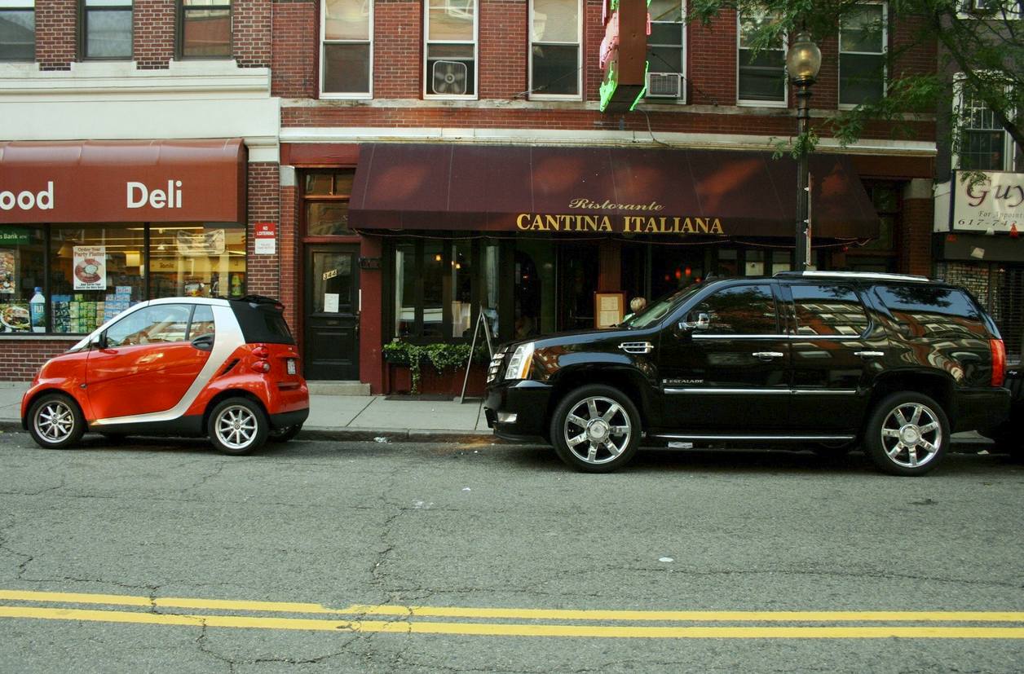
C
http://www.fotopedia.com/items/flickr-2683571037
Notes:
Another layer of indirection
Keep aspects thin, have them delegate to another class
a plain old object that’s not tied to a specific AOP framework
And since the aspects themselves are extremely thin, you can easily test the plain-old-object directly

Slide 16
{ Contact me }
http://about.me/mgroves
https://github.com/mgroves/AOPForYouAndMe
http://crosscuttingconcerns.com
http://manning.com/groves
42% off code: 12mp25

